Slide 1

INTRODUCTION TO STATISTICAL DATA ANALYSIS USING R & RSTUDIO
LUMUMBA WANDERA VICTOR
(M.Sc. Applied Statistics)
11th February, 2025
.

Slide 2
Session 2: Data Importation, Cleaning and Exploratory Data Analysis (EDA)
Data Importation
CSV Files
Commonly used format for structured data.
Can be imported using base R or readr package for efficiency.
Text Files
Can be space- or tab-separated.
Requires specifying delimiters.
Excel Files
R does not natively support Excel files.
The readxl package is commonly used for importing .xlsx and .xls files.
SPSS, Stata, and SAS Files
Imported using foreign or haven package.
The haven package is preferred for modern data formats.
2/8/2025
CENTER FOR DATA ANALYTICS AND MODELING, CHUKA UNIVERSITY
2

Slide 3
Session 2: Data Importation, Cleaning and Exploratory Data Analysis (EDA)
Data Importation
JSON Files
Used for semi-structured data, often in web applications.
Can be imported using the jsonlite package.
Databases
Requires connecting to a database using the DBI package.
SQL queries can be used to extract specific data.
Web Data
R can read data directly from URLs.
Used for real-time or open-source datasets.
Data Inspection
Always check structure, missing values, and correctness after importation.
Would you like a more detailed summary on any of these?
2/8/2025
CENTER FOR DATA ANALYTICS AND MODELING, CHUKA UNIVERSITY
2

Slide 4
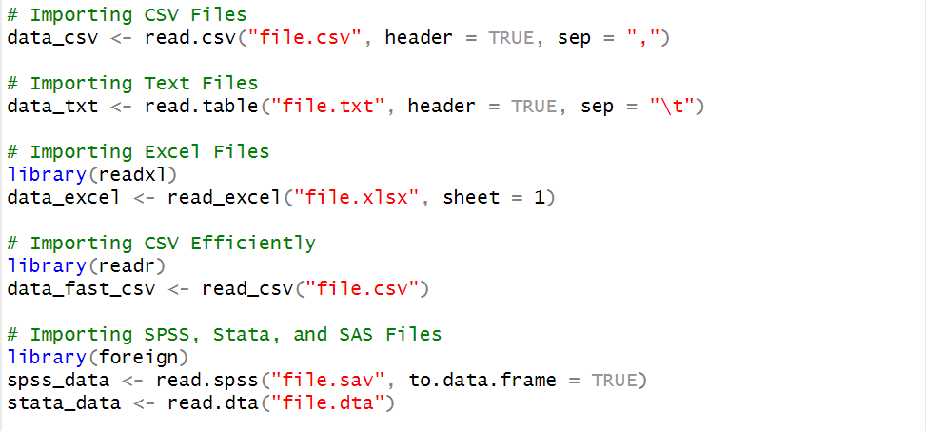
Session 2: Data Importation, Cleaning and Exploratory Data Analysis (EDA)
Sample R Codes for csv, table, excel and spss Files
2/8/2025
CENTER FOR DATA ANALYTICS AND MODELING, CHUKA UNIVERSITY
2

Slide 5
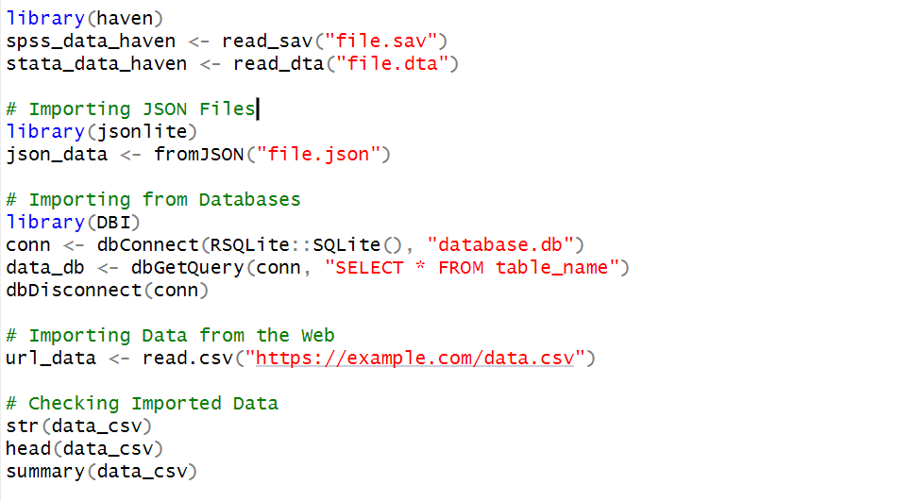
Session 2: Data Importation, Cleaning and Exploratory Data Analysis (EDA)
Sample R Codes for csv, table, excel and spss Files
2/8/2025
CENTER FOR DATA ANALYTICS AND MODELING, CHUKA UNIVERSITY
2

Slide 6
Session 2: Data Importation, Cleaning and Exploratory Data Analysis (EDA)
Data Cleaning
1. Handling Missing Values
For Numeric Data:
Can be replaced with the mean, median, or mode.
Alternatively, interpolation or predictive modeling can be used for imputation.
For Categorical Data:
Can be replaced with the most frequent category (mode).
Missing categories can be treated as a separate category if meaningful.
Dropping Missing Values:
If missing values are excessive, removing affected rows or columns may be necessary.
2/8/2025
CENTER FOR DATA ANALYTICS AND MODELING, CHUKA UNIVERSITY
2

Slide 7
Session 2: Data Importation, Cleaning and Exploratory Data Analysis (EDA)
Data Cleaning
2. Handling Outliers
Detection Methods:
Using summary statistics like interquartile range (IQR).
Using standard deviation and Z-scores.
Treatment Approaches:
Removing extreme outliers if they are errors.
Transforming data (e.g., logarithmic transformation) to minimize their effect.
Capping or Winsorization to limit extreme values.
2/8/2025
CENTER FOR DATA ANALYTICS AND MODELING, CHUKA UNIVERSITY
2

Slide 8
Session 2: Data Importation, Cleaning and Exploratory Data Analysis (EDA)
Data Cleaning
3. Variables Transformation
Scaling and Normalization:
Used to bring numerical variables to a common scale (e.g., min-max scaling, standardization).
Log and Power Transformations:
Helps in normalizing skewed data.
Categorical Encoding:
Converts categorical variables into numerical formats (e.g., one-hot encoding, label encoding).
2/8/2025
CENTER FOR DATA ANALYTICS AND MODELING, CHUKA UNIVERSITY
2

Slide 9
Session 2: Data Importation, Cleaning and Exploratory Data Analysis (EDA)
Data Cleaning
4. Renaming Columns, Removing Unnecessary Columns and Duplicates
Renaming Columns
Useful for improving readability and consistency in naming conventions.
Helps avoid conflicts with special characters or spaces in column names.
Removing Unnecessary Columns
Columns that are irrelevant or redundant should be dropped to enhance model performance.
Highly correlated variables may also be removed to avoid multicollinearity.
Duplicates Handling
Checking and removing duplicate rows prevents biases in analysis.
Sometimes, partial duplicates (same values except for minor variations) need special handling.
2/8/2025
CENTER FOR DATA ANALYTICS AND MODELING, CHUKA UNIVERSITY
2

Slide 10
Session 2: Data Importation, Cleaning and Exploratory Data Analysis (EDA)
Data Cleaning
Handling Inconsistency and Feature Engineering
Handling Inconsistent Data
Standardizing categorical variables (e.g., ensuring "Male" and "M" are treated as the same).
Ensuring numerical variables follow a logical range (e.g., age values are non-negative).
Feature Engineering
Creating new meaningful variables from existing data (e.g., combining date columns to create age or tenure).
Binning continuous variables into categorical groups for better interpretability.
String Cleaning
Removing extra spaces, special characters, or converting text to lowercase for consistency.
Handling Date and Time Variables
Converting date columns into appropriate formats.
Extracting useful features like year, month, day, or weekdays for analysis.
2/8/2025
CENTER FOR DATA ANALYTICS AND MODELING, CHUKA UNIVERSITY
2

Slide 11
Session 2: Data Importation, Cleaning and Exploratory Data Analysis (EDA)
Data Cleaning
Handling Inconsistency and Feature Engineering
Handling Inconsistent Data
Standardizing categorical variables (e.g., ensuring "Male" and "M" are treated as the same).
Ensuring numerical variables follow a logical range (e.g., age values are non-negative).
Feature Engineering
Creating new meaningful variables from existing data (e.g., combining date columns to create age or tenure).
Binning continuous variables into categorical groups for better interpretability.
String Cleaning
Removing extra spaces, special characters, or converting text to lowercase for consistency.
Handling Date and Time Variables
Converting date columns into appropriate formats.
Extracting useful features like year, month, day, or weekdays for analysis.
2/8/2025
CENTER FOR DATA ANALYTICS AND MODELING, CHUKA UNIVERSITY
2

Slide 12
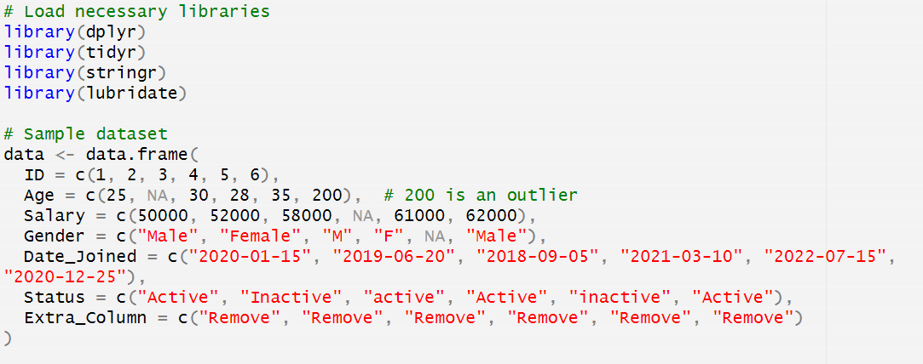
Session 2: Data Importation, Cleaning and Exploratory Data Analysis (EDA)
Data Cleaning (Sample R Codes)
2/8/2025
CENTER FOR DATA ANALYTICS AND MODELING, CHUKA UNIVERSITY
2

Slide 13
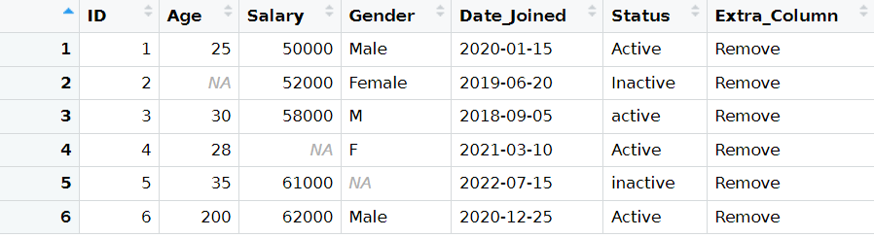
Session 2: Data Importation, Cleaning and Exploratory Data Analysis (EDA)
Data Cleaning (Sample Data)
2/8/2025
CENTER FOR DATA ANALYTICS AND MODELING, CHUKA UNIVERSITY
2

Slide 14
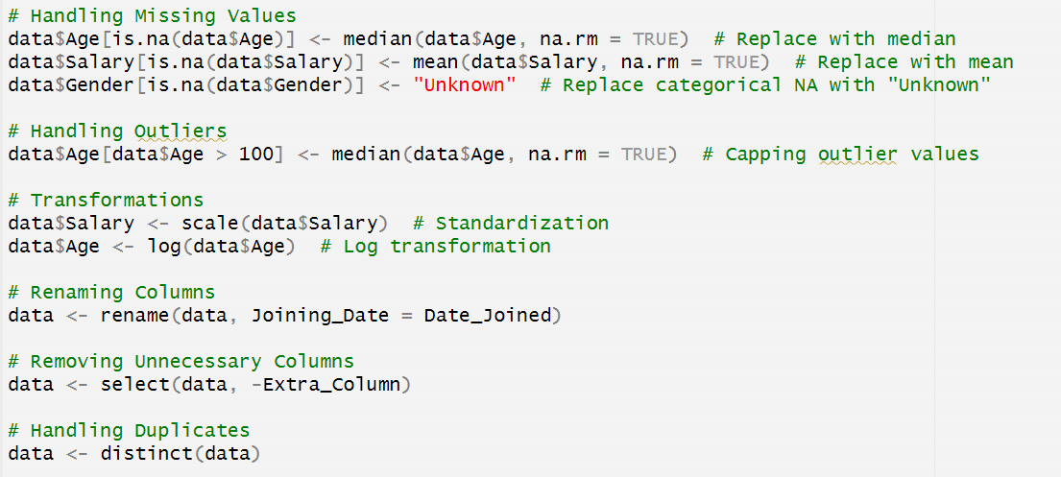
Session 2: Data Importation, Cleaning and Exploratory Data Analysis (EDA)
Data Cleaning (Sample R Codes)
2/8/2025
CENTER FOR DATA ANALYTICS AND MODELING, CHUKA UNIVERSITY
2

Slide 15
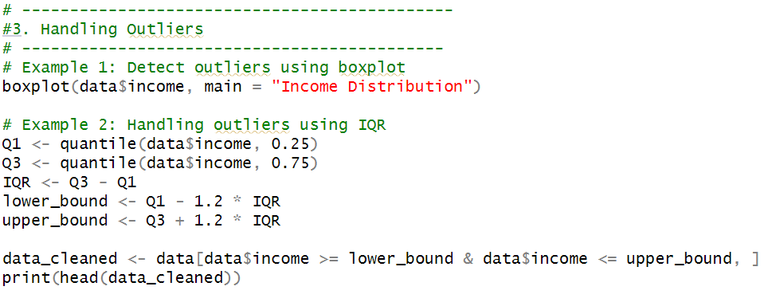
Session 2: Data Importation, Cleaning and Exploratory Data Analysis (EDA)
Data Cleaning (Sample R Codes) Alternative way of Handling Outliers
2/8/2025
CENTER FOR DATA ANALYTICS AND MODELING, CHUKA UNIVERSITY
2

Slide 16
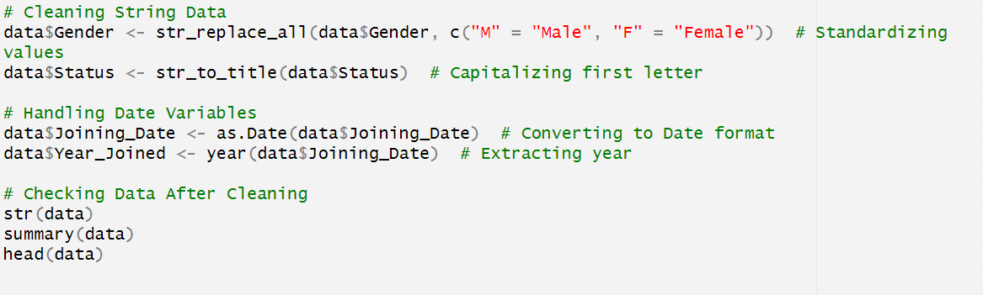
Session 2: Data Importation, Cleaning and Exploratory Data Analysis (EDA)
Data Cleaning (Sample R Codes)
2/8/2025
CENTER FOR DATA ANALYTICS AND MODELING, CHUKA UNIVERSITY
2

Slide 17
Session 2: Data Importation, Cleaning and Exploratory Data Analysis (EDA)
Exploratory Data Analysis (EDA)
1. Histogram
Used to visualize the distribution of a single numeric variable.
Helps identify skewness, modality (unimodal, bimodal), and presence of outliers.
2. Boxplot (Box-and-Whisker Plot)
Displays the distribution of a numeric variable and identifies outliers.
Useful for comparing distributions across different categories.
3. Scatter Plot
Shows relationships between two numeric variables.
Helps detect patterns, correlations, and potential outliers.
2/8/2025
CENTER FOR DATA ANALYTICS AND MODELING, CHUKA UNIVERSITY
2

Slide 18
Session 2: Data Importation, Cleaning and Exploratory Data Analysis (EDA)
Exploratory Data Analysis (EDA)
4. Bar Chart
Used for visualizing categorical variables.
Shows frequency or proportion of different categories.
5. Heatmap
Represents correlations between multiple variables.
Helps identify multicollinearity and patterns in large datasets.
6. Pair Plot (Scatterplot Matrix)
Displays relationships between multiple numeric variables in one view.
Useful for detecting patterns and correlations in high-dimensional data.
2/8/2025
CENTER FOR DATA ANALYTICS AND MODELING, CHUKA UNIVERSITY
2

Slide 19
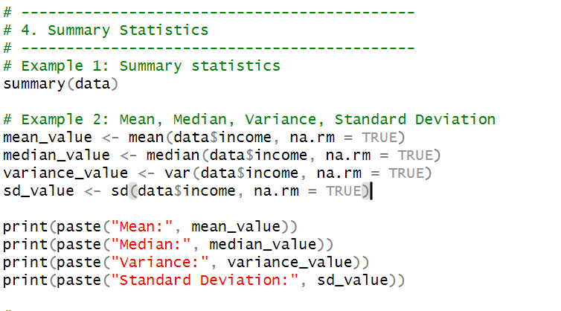
Session 2: Data Importation, Cleaning and Exploratory Data Analysis (EDA)
Exploratory Data Analysis (Sample R codes) Summary Statistics
2/8/2025
CENTER FOR DATA ANALYTICS AND MODELING, CHUKA UNIVERSITY
2

Slide 20
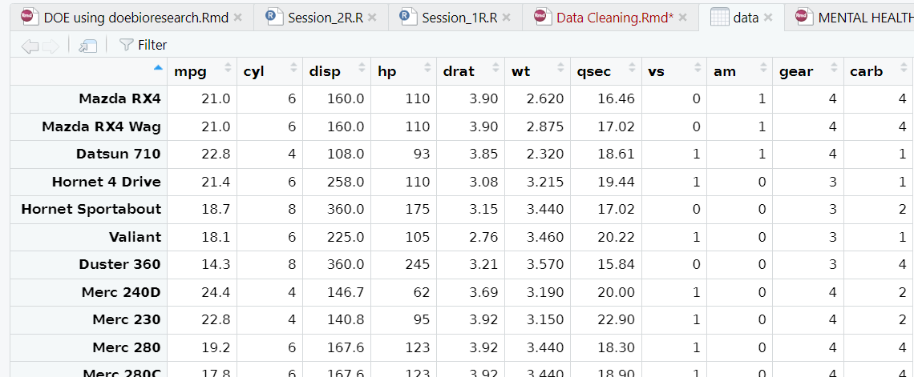
Session 2: Data Importation, Cleaning and Exploratory Data Analysis (EDA)
Exploratory Data Analysis (Sample Data)
2/8/2025
CENTER FOR DATA ANALYTICS AND MODELING, CHUKA UNIVERSITY
2

Slide 21
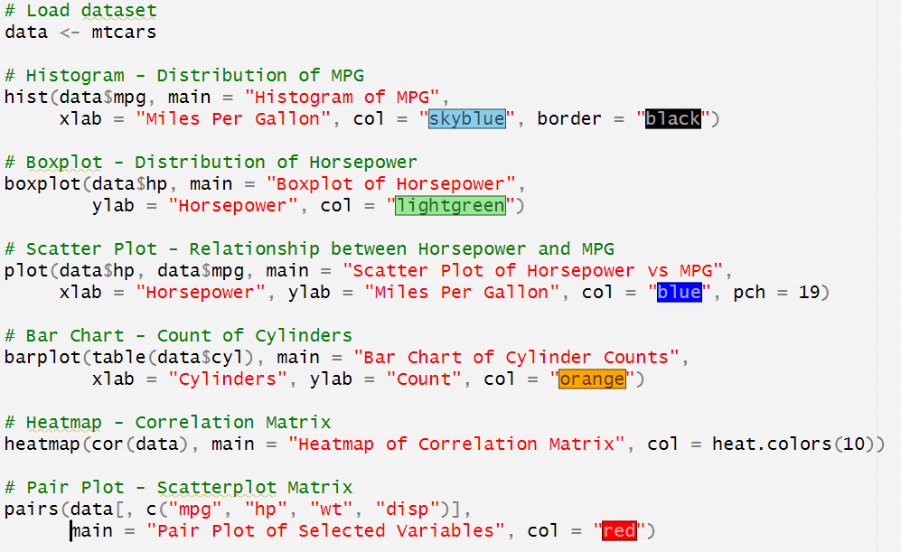
Session 2: Data Importation, Cleaning and Exploratory Data Analysis (EDA)
Exploratory Data Analysis (Sample R codes) Base Visuals
2/8/2025
CENTER FOR DATA ANALYTICS AND MODELING, CHUKA UNIVERSITY
2

Slide 22
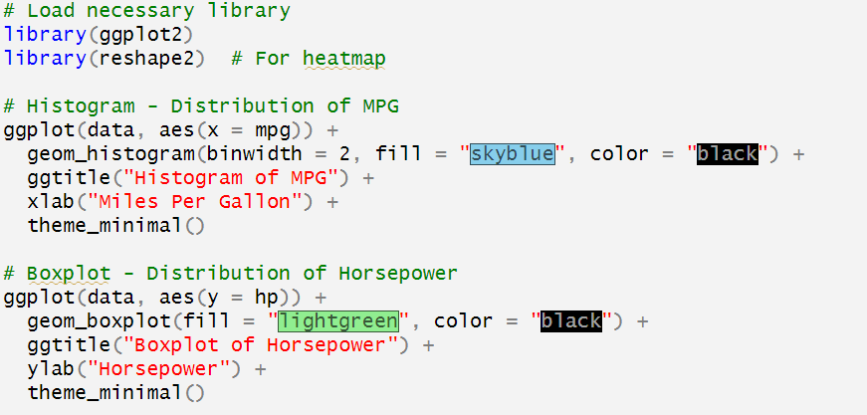
Session 2: Data Importation, Cleaning and Exploratory Data Analysis (EDA)
Exploratory Data Analysis (Sample R codes) Advanced Visuals
1. Histogram, and Box plot (Whisker’s Plot)
2/8/2025
CENTER FOR DATA ANALYTICS AND MODELING, CHUKA UNIVERSITY
2

Slide 23
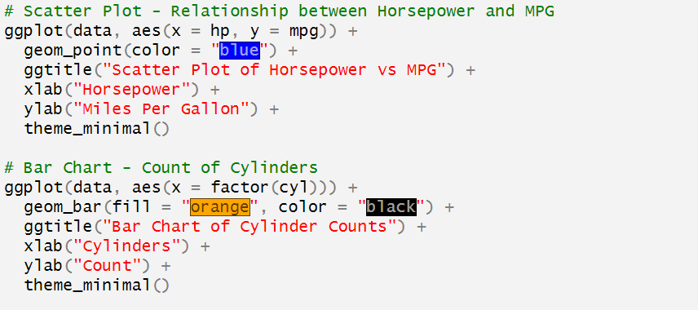
Session 2: Data Importation, Cleaning and Exploratory Data Analysis (EDA)
Exploratory Data Analysis (Sample R codes) Advanced Visuals
2. Scatter Plot and Bar Chart
2/8/2025
CENTER FOR DATA ANALYTICS AND MODELING, CHUKA UNIVERSITY
2

Slide 24
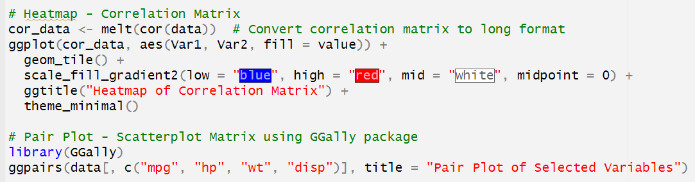
Session 2: Data Importation, Cleaning and Exploratory Data Analysis (EDA)
Exploratory Data Analysis (Sample R codes) Advanced Visuals
3. Heatmap and Pairs Plot
2/8/2025
CENTER FOR DATA ANALYTICS AND MODELING, CHUKA UNIVERSITY
2

Slide 25
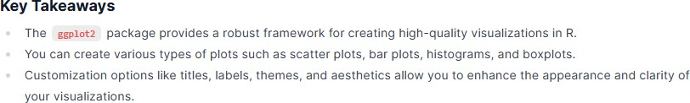
Session 4: Data Visualization with ggplot2
2/8/2025
CENTER FOR DATA ANALYTICS AND MODELING, CHUKA UNIVERSITY

Slide 26

https://cdam.chuka.ac.ke
Thank you
2/8/2025
CENTER FOR DATA ANALYTICS AND MODELING, CHUKA UNIVERSITY

